Slide 1
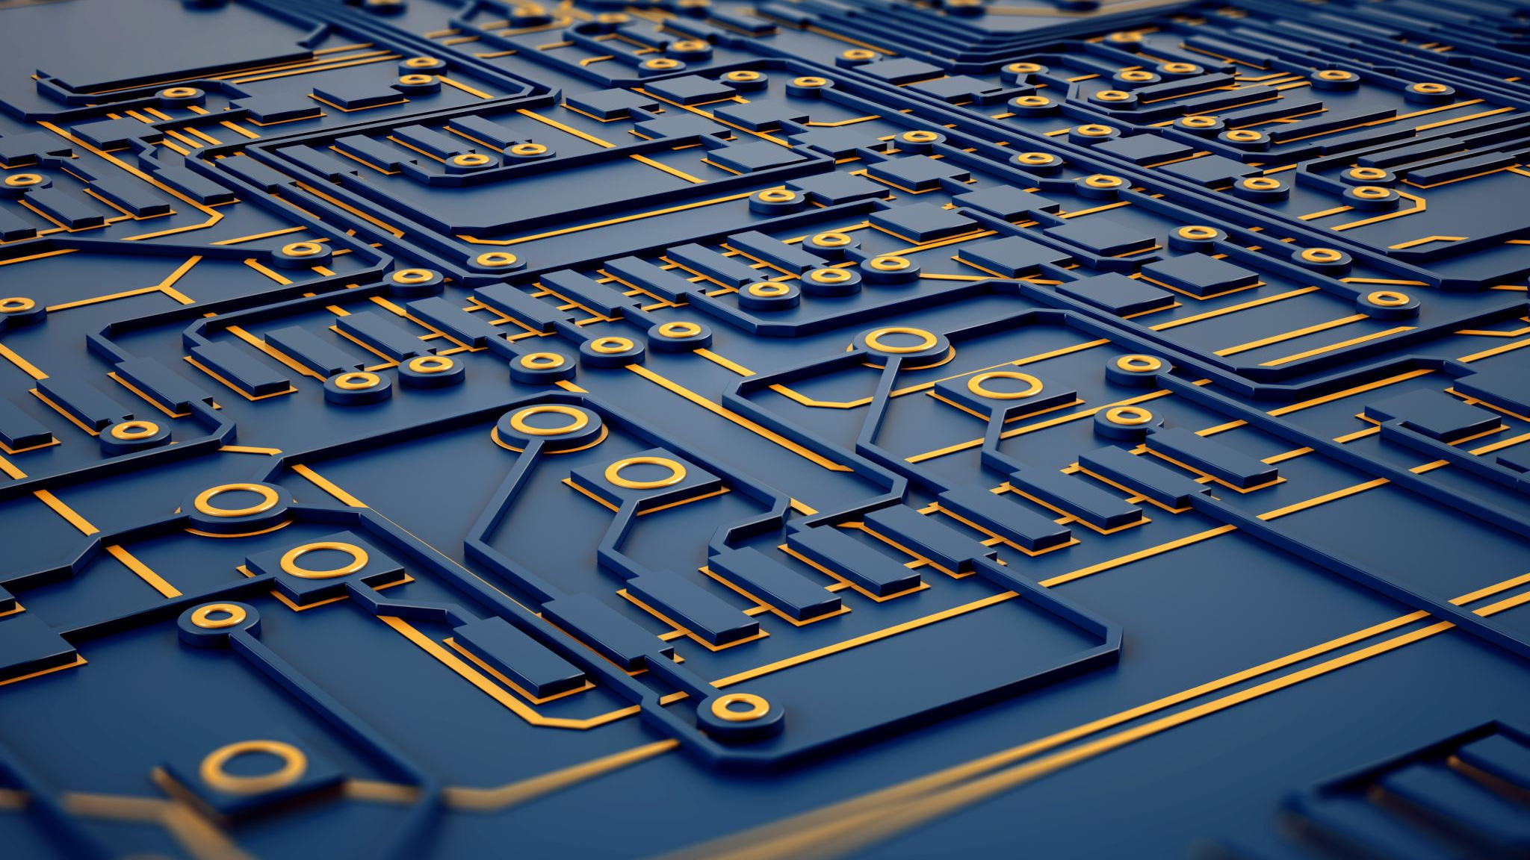
Semiconductors
By Quang Huynh

Slide 2
My personal Ranking of The Videos
How Does a Transistor Work? by Veritasium – The video itself was very entertaining and very educational at the same time.
What Is A Semiconductor? by MITK12Videos – I enjoyed the little animations since they added a sense of amusement to the video.
How semiconductors work by Ben Eater – The video was very lengthy, yet it thoroughly explained what a semiconductor is.

Slide 3
Electricity Insulators and conductors
Insulators – A material that does not have much conductivity and so it does not conduct electricity easily.
Conductor – Materials that allow electrons to flow freely from particle to particle and conducts electricity very easily.

Slide 4
Insulator Examples
Glass
Rubber
Plastic
Wood
Clothes

Slide 5
Conductor Examples
Metals
Copper
Aluminum
Steel
Gold

Slide 6
Semiconductor
A silicon wafer is an insulator when no heat is added. When heat is applied, the silicon wafer turns on the light and becomes a conductor. A semiconductor is a substance whose conductivity changes based on the environment.

Slide 7
Uses of Semiconductors
Diodes
Transistors
Circuits
Computer chips

Slide 8
Semiconductor Benefits
Semiconductors allowed electronics to be smaller, faster and more reliable.

Slide 9
How it works
In atoms, electrons can occupy specific energy levels. Then, when multiple atoms bond, the electrons are shared between them. The energy levels shift around when they are interacting. The individual energy level would smear into energy bands. For a material to conduct, the electrons must be able to jump from lower energy states to higher ones. The spacing of the energy levels and how they are filled with electrons determines if a material is an insulator, conductor or semiconductor.

Slide 10
Different Energy Gaps
If there is a huge gap in the energy levels, then it is more difficult for the electrons to jump to the higher ones. Metals have no energy level gap; thus energy can freely move to the higher energy levels with ease. Semiconductors fall somewhere in between both an inductor and conductor.

